Slide 1

Northwestern Bootcamp Project 3
Alan, Heather, & Jarvis

Slide 2
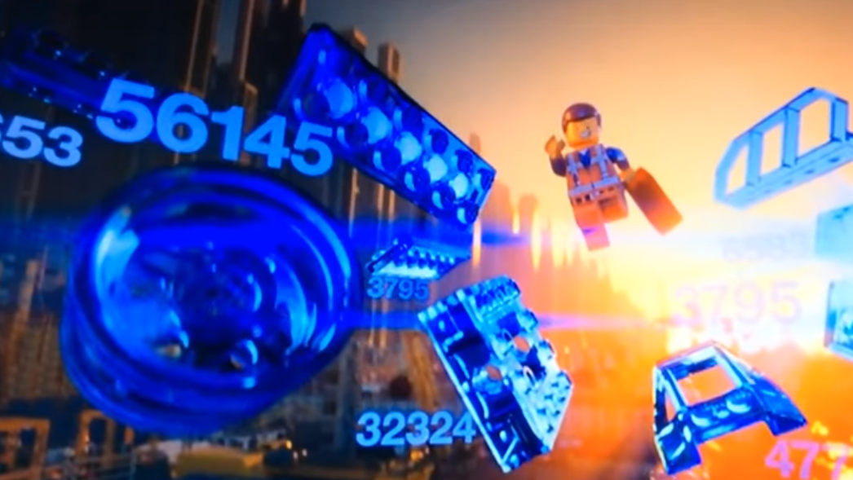
How can I be a master builder using ML?

Slide 3

How much should a Lego set really cost?

Slide 4


Getting our data….
If you think your data is clean, you haven’t looked at it hard enough

Slide 5

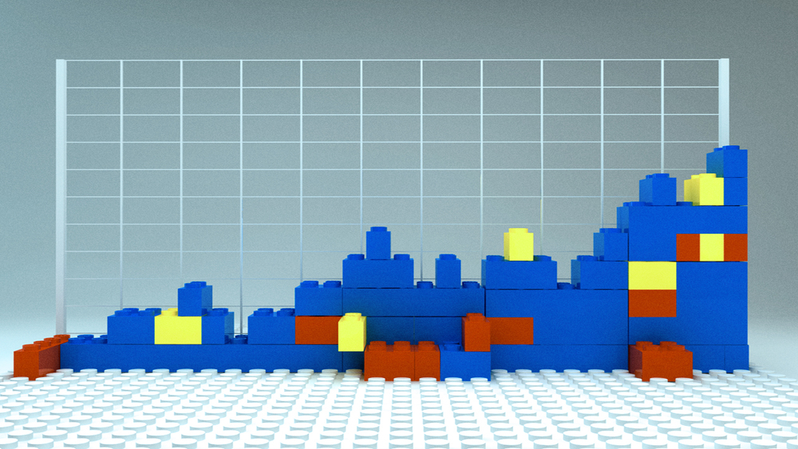
Correlation Diagram and Linear Relationships

Slide 6
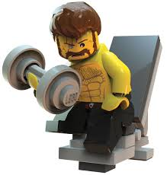

Training our model Linear Regression
Running Predictions

Slide 7
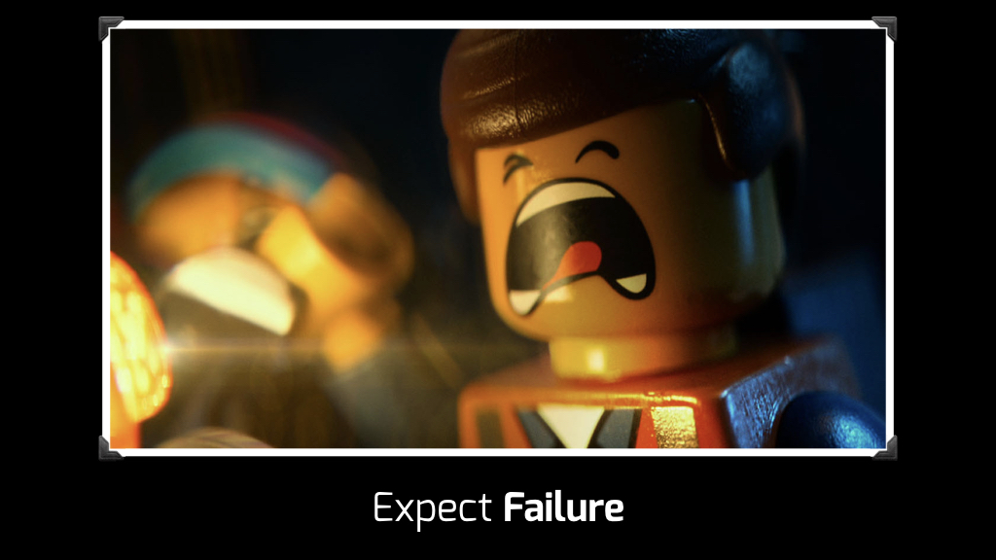

Slide 8
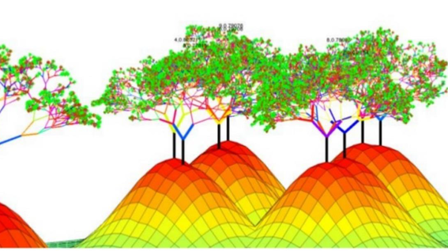

We need a BOOST!!!

Slide 9

Wrong vs Right??

Slide 10

Questions?

